Slide 1
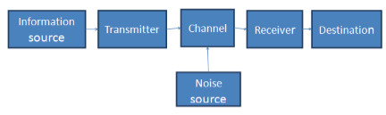
Communication system

Slide 2
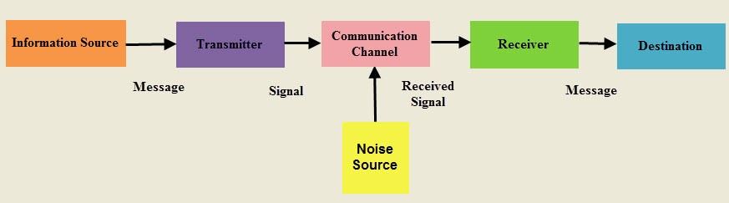

Slide 3

A Communication System as a System Example
A communication system has an information signal plus noise signals
This is an example of a system that consists of an interconnection of smaller systems

Slide 4
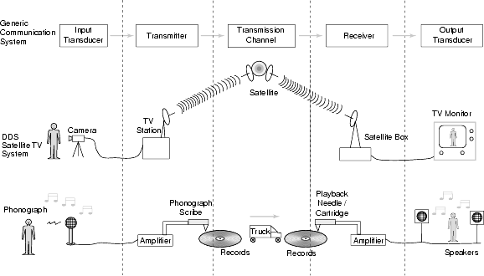

Slide 5
The block diagram of a communication system will have five blocks, including the information source,transmitter, channel, receiver and destination blocks.
1.Information source :-
The objective of any communication system is to convey information from one point to the other. The information comes from the information source, which originates it
Information is a very generic word signifying at the abstract level anything intended for communication, which may include some thoughts, news, feeling, visual scene, and so on.
The information source converts this information into physical quantity.
The physical manifestation of the information is termed as message signal
2.Transmitter :-
The objective of the transmitter block is to collect the incoming message signal and modify it in a suitable fashion (if needed), such that, it can be transmitted via the chosen channel to the receiving point.
Channel is a physical medium which connects the transmitter block with the receiver block.
The functionality of the transmitter block is mainly decided by the type or nature of the channel chosen for communication.

Slide 6
3.Channel :-
Channel is the physical medium which connects the transmitter with that of the receiver.
The physical medium includes copper wire, coaxial cable, fibre optic cable, wave guide and free space or atmosphere.
The choice of a particular channel depends on the feasibility and also the purpose of the communication system.
4.Receiver:-
The receiver block receives the incoming modified version of the message signal from the channel and processes it to recreate the original (non-electrical) form of the message signal.
There are a great variety of receivers in communication systems, depending on the processing required to recreate the original message signal and also final presentation of the message to the destination.
5.Destination:-
The destination is the final block in the communication system which receives the message signal and processes it to comprehend the information present in it.
Usually, humans will be the destination block.

Slide 7
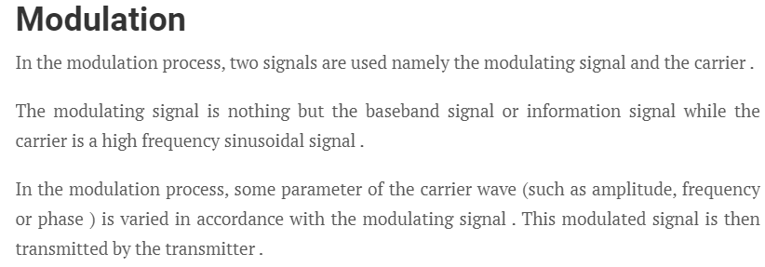
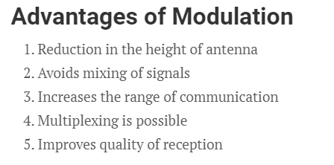

Slide 8
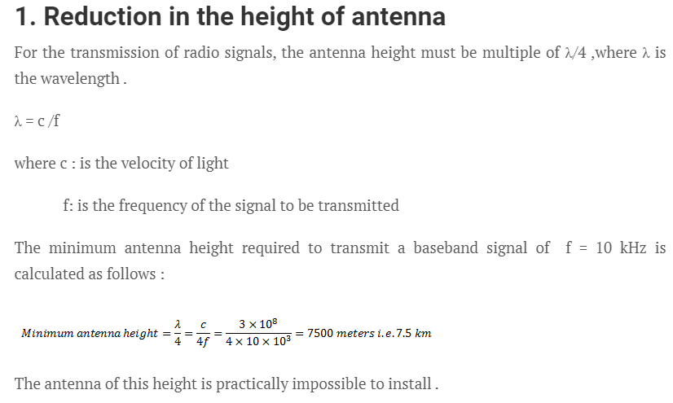

Slide 9
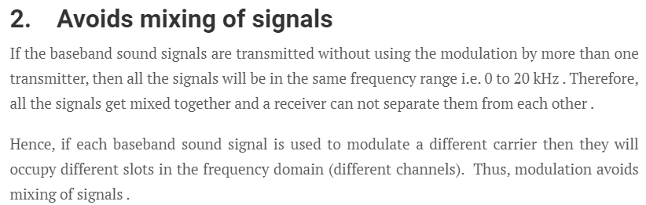
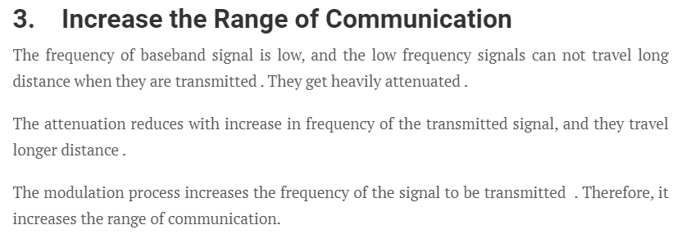

Slide 10
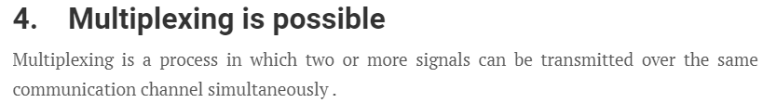
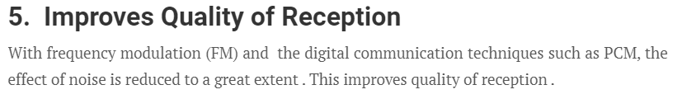

Slide 11
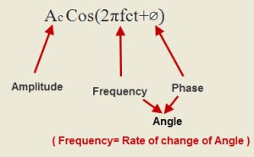
Analog Modulation
In analog modulation, analog signal (sinusoidal signal) is used as a carrier signal that modulates the message signal or data signal.
The general function Sinusoidal wave’s is shown in the figure below, in which, three parameters can be altered to get modulation – they are amplitude, frequency and phase.

Slide 12
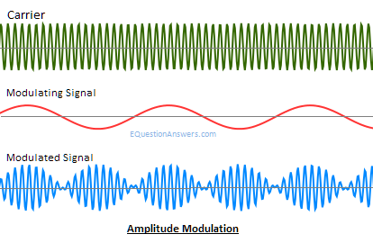
Amplitude Modulation
Amplitude modulation was developed in the beginning of the 20th century. It was the earliest modulation technique used to transmit voice by radio. This type of modulation technique is used in electronic communication.
In this modulation, the amplitude of the carrier signal varies in accordance with the message signal, and other factors like phase and frequency remain constant.
This type of modulation requires more power and greater bandwidth. Filtering is very difficult.
Amplitude modulation is used in computer modems, VHF aircraft radio, and in portable two-way radio.

Slide 13
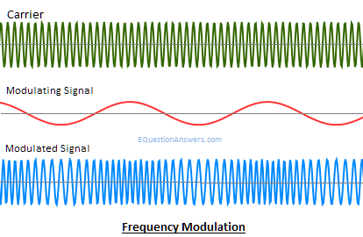
Frequency Modulation
In this type of modulation, the frequency of the carrier signal varies in accordance with the message signal, and other parameters like amplitude and phase remain constant.
Frequency modulation is used in different applications like radar, radio and telemetry, seismic prospecting and monitoring newborns for seizures via EEG, etc.
This type of modulation is commonly used for broadcasting music and speech, magnetic tape recording systems, two way radio systems and video transmission systems.
When noise occurs naturally in radio systems, frequency modulation with sufficient bandwidth provides an advantage in cancelling the noise.

Slide 14
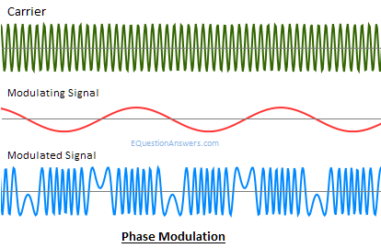
Phase Modulation
In this type of modulation, the phase of the carrier signal varies in accordance with the message signal.
When the phase of the signal is changed, then it affects the frequency. So, for this reason, this modulation is also comes under the frequency modulation.
Generally, phase modulation is used for transmitting waves.
It is an essential part of many digital transmission coding schemes that underlie a wide range of technologies like GSM, WiFi, and satellite television.

Slide 15
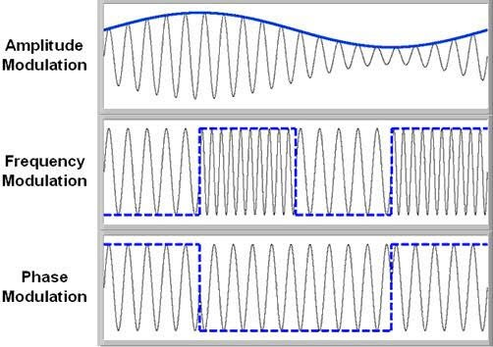
Types of Analog Modulation

Slide 16
MODULATION
Modulation is defined as a process by which same characteristic of a signal called carrier is varied in accordance with instantaneous value of another signal called modulating signal.
Signal containing information or intelligence to be transmitted are referred to a modulating signal.it is also called as baseband signal.
The carrier frequency >modulating frequency.
Process in which characteristics of a carrier wave is varied with instantaneous value of message(modulating)signal.

Slide 17
Generations of AM,FM and PM waves
Modulation system
Continuous wave (or) analog modulation signal
Pulse modulation signal
Phase modulation
Amplitude modulation
Frequency modulation
Pulse amplitude modulation
Pulse width modulation
Pulse code modulation
Delta modulation

Slide 18
There are two types of analog modulation:
Amplitude modulation- Amplitude of the carrier wave is varied in accordance with the instant value of modulating signal.
Angle modulation- Total phase angle of the carrier wave is varied in accordance with the modulating signal .Total angle can be varied by frequency or phase.

Slide 19
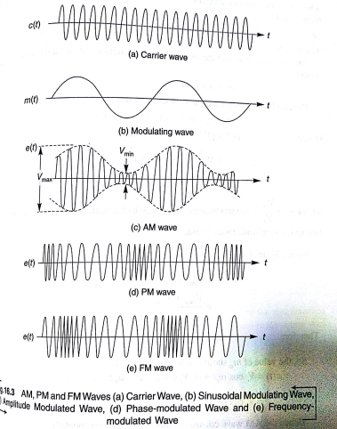

Slide 20
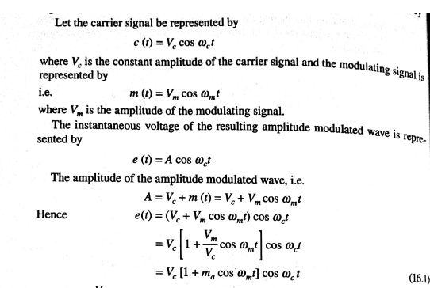

Slide 21
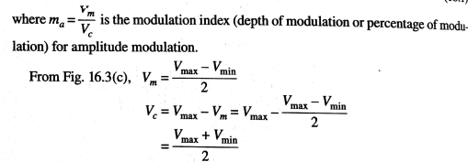

Slide 22
Frequency Modulation
In frequency modulation, the carrier amplitude remains constant , while carrier frequency is changed by the modulating signal.
Amplitude of modulating signal increases, then carrier frequency increases and vice versa.
The inverse is also possible
Amplitude of modulating signal increases, then carrier frequency decreases and vice versa.

Slide 23
Phase Modulation
Phase of the carrier wave is varied in accordance with the instant value of modulating signal.
Phase angle cannot change without affecting frequency.
So phase and frequency modulation are inter related with eachother

Slide 24
Demodulation
It is the process of separating message signal from the modulated carrier signal.
This process is exactly opposite to that of modulation at the transmitter.

